Slide 1
Comparative analysis of data mining for diabetes prediction
Varnasri K- 71762131058

Slide 2
Problem Statement
Diabetes is a chronic and potentially debilitating condition affecting millions of people worldwide, leading to severe health complications if not managed effectively.
Early detection and timely intervention are critical to mitigating the adverse effects of diabetes and improving patient outcomes.
This project addresses the primary challenge of developing a reliable predictive model that accurately determines the likelihood of an individual having diabetes based on various health indicators such as glucose level, blood pressure, BMI, and other relevant features.
By leveraging data mining techniques and machine learning algorithms, this project aims to provide a robust tool for individuals to assess their risk of diabetes, thereby facilitating early detection and intervention.

Slide 3
Abstract
The rising prevalence of diabetes necessitates effective prediction tools for early diagnosis and treatment.
This project aims to develop a predictive model for diabetes based on a dataset containing medical parameters like glucose levels, BMI, age etc.
By preprocessing data, normalizing features, and applying logistic regression, decision tree, and K-nearest neighbors classifiers, we identify the best model for predicting diabetes and also identifying the risk factor.
The project also includes a real-time prediction function based on user input. and a risk prediction component to categorize diabetes risk levels based on glucose values.

Slide 4
Dataset
Pregnancies: More frequent pregnancies may affect health conditions such as diabetes due to hormonal changes.
Glucose: Higher glucose levels are a direct indicator of diabetes.
Blood Pressure: Hypertension is often associated with diabetes.
Skin Thickness: It can be an indicator of body fat, which is related to diabetes.
Insulin: Insulin levels are critical in the diagnosis and management of diabetes.
BMI (Body Mass Index): Higher BMI values are associated with obesity, which is a risk factor for diabetes.

Slide 5
Diabetes Pedigree Function: A higher value indicates a higher risk of diabetes.
Age: Age is a significant risk factor for diabetes. Older individuals are more likely to develop diabetes.
HbA1c Levels: Higher HbA1c levels indicate poorer blood sugar control and a higher risk of diabetes.
Stress Levels: Higher stress levels can increase the risk of developing diabetes.
Sleep Quality: Poor sleep quality can negatively affect metabolic processes, including glucose metabolism, potentially leading to diabetes.
Family History: A positive family history (having relatives with diabetes) increases the likelihood of developing diabetes due to genetic factors.
Outcome: This is the target variable indicating whether the individual has diabetes (1) or not (0).

Slide 6
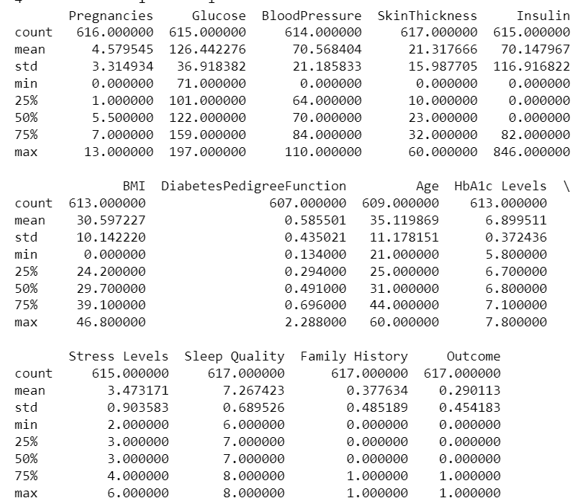
Data Cleaning and Preprocessing:
Summary Statistics:
print(data.describe()) generates a summary of the dataset's statistical properties, including measures like mean, median, standard deviation, and percentiles for numerical columns.
Inference: The dataset contains a mix of continuous and binary variables.
Several columns have 0 values that likely indicate missing data (e.g., Insulin, Skin Thickness, BMI).
Most variables show some degree of skewness, with notable differences between means and medians.
The distribution of binary variables (Family History and Outcome) shows a clear divide.
Output:

Slide 7
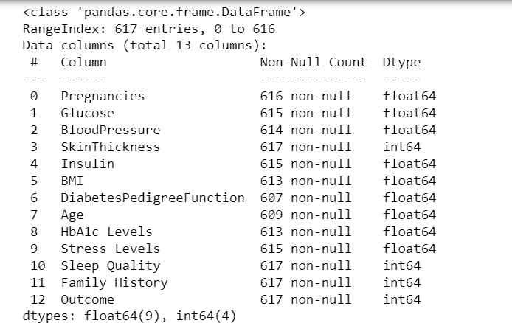
Data Information
print(data.info()) provides a concise summary of the DataFrame, including the number of entries, data types of each column, and memory usage.
The output shows that the dataset is a DataFrame with 617 entries, indexed from 0 to 616.It contains 13 columns.
Inference:Dataset Completeness: The dataset is mostly complete, but some columns have missing values that need to be handled during preprocessing.

Slide 8
Data Cleaning and Preprocessing:
Fill Missing Values: Datafolha(data.mean(), inplace=True) replaces missing values in the dataset with the mean of the respective columns.
This is a common strategy for handling missing data, especially for numerical columns, as it helps to retain the dataset's size and structure while minimizing potential bias introduced by missing values.
Removing Duplicate Rows:
Drop Duplicates: data.drop_duplicates(inplace=True) removes any duplicate rows from the dataset.
Duplicates can skew analysis and model training, so removing them helps to ensure the integrity and accuracy of the data.

Slide 9

Outlier Detection:
Z-scores help identify outliers in the data.
A data point with a Z-score greater than 3 or less than -3 is often considered an outlier.
Outliers can skew results and affect the performance of machine learning models, so detecting and addressing them is crucial.

Slide 10
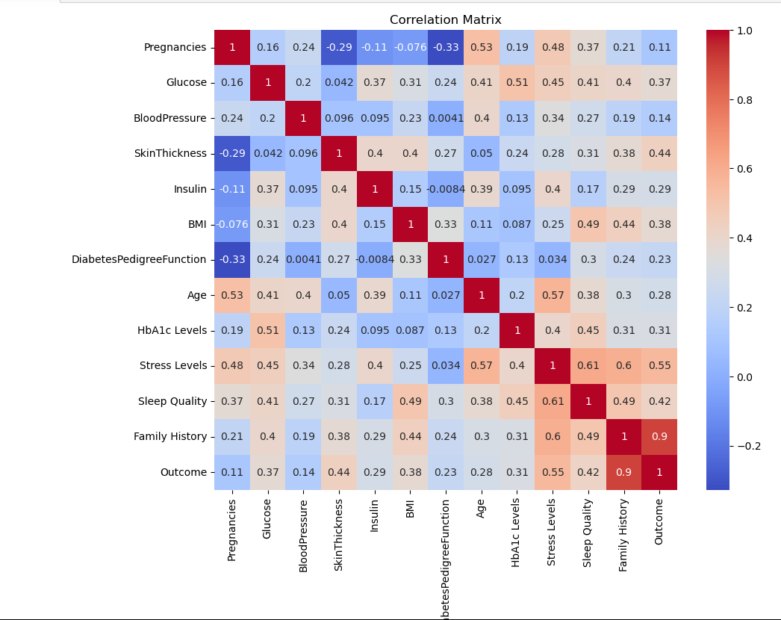
Correlation Analysis

Slide 11
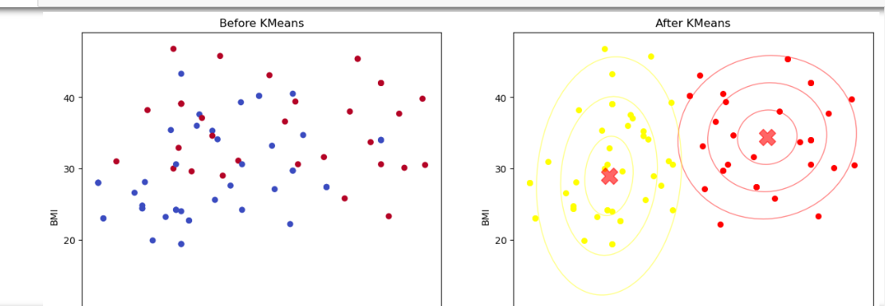
K-Means Clustering

Slide 12
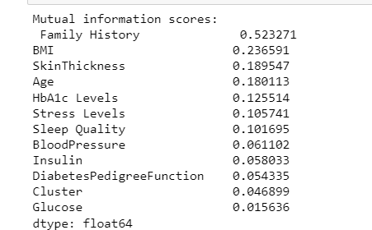
Mutual Information
Mutual information measures the dependency between each feature and the target variable. A higher mutual information score indicates a stronger relationship between the feature and the target variable.

Slide 13
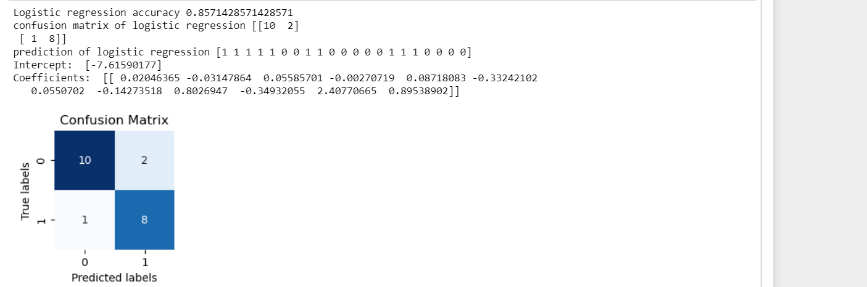
Logistic Regression
Logistic regression is well-suited for binary classification problems like predicting whether an outcome is 0 or 1.
It provides coefficients that can be easily interpreted to understand the influence of each feature on the probability of the outcome.
Logistic regression is computationally efficient and performs well when the relationship between the features and the target variable is approximately linear.

Slide 14
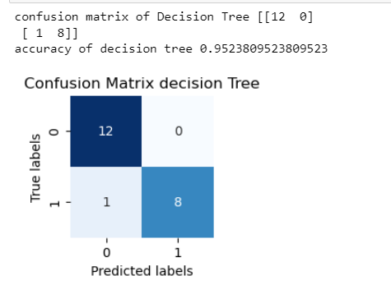
Decision Tree
Non-linear Relationships: Decision trees can capture non-linear relationships between features and the target variable.
Interpretability: The model is easy to interpret as it mimics human decision-making processes and can show feature importance.

Slide 15
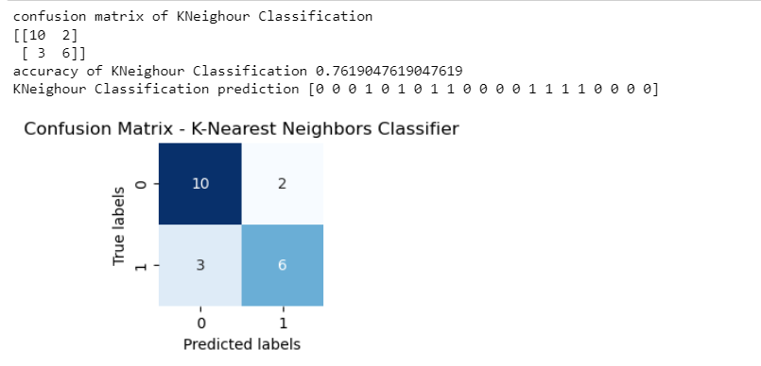
K-Nearest Neighbors (KNN):
Instance-Based Learning: KNN is a non-parametric method that makes predictions based on the closest training examples in the feature space.
Simplicity: It is simple to understand and implement.

Slide 16
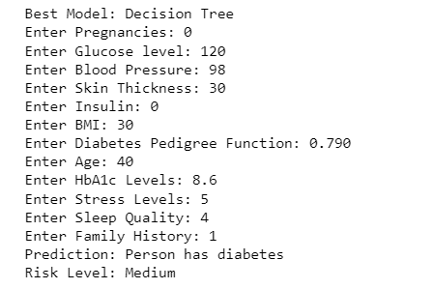
Best Model

Slide 17
Best Model –Decision Tree
Decision Trees can capture non-linear relationships between the features and the target variable. In the case of diabetes prediction, the relationship between features such as glucose level, insulin, BMI, age, etc., and the outcome not be linear.
Decision Trees can effectively model these complex interactions
Decision Trees can automatically determine the most important features for making predictions.
Features like glucose level, insulin, and BMI might have significant impacts on the prediction of diabetes, and the Decision Tree can prioritize these features in its splits.

Slide 18
Conclusion
This project successfully developed a predictive model for diabetes diagnosis.
After comparing multiple models, the Decision Tree model was identified as the most accurate.
The project demonstrates the effectiveness of data mining in medical diagnostics and provides a practical tool for early diabetes detection.
The final model can predict diabetes risk with a high degree of accuracy, potentially aiding healthcare professionals in making informed decisions.

